Slide 1
Setting Airplane and Radio for Precision Aerobatics
Notes:
INTRODUCTION
Introduce yourself.
Welcome everyone
Explain where any restrooms are located.
Give the students some of your background. This helps them to know what is "expected" when it is their turn to introduce themselves.
If there is time, have each student introduce themselves. This will give you a good idea of the experience level of the class and will break the ice.

Slide 2
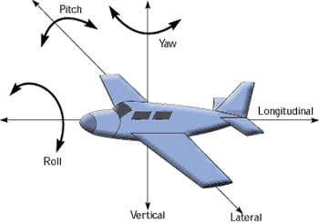
Seminar Outline
General Principles
Airplane Key Settings
Permanent Radio Settings
Activated Radio Settings
Radio Flight Conditions
Notes:
COURSE OVERVIEW
This section deals with Judging Criteria for Scale Aerobatics.
Explain that being a good judge is not terrible difficult but it does require a thorough knowledge of the criteria and the ability to apply it quickly and decisively. Each judge must develop their own method of keeping track of the cumulative downgrades for each figure.
Being a good judge does not necessarily go hand-in-hand with being a good pilot. As a matter of fact, being a pilot is not a criteria at all.
(CAUTION - NON P.C. Statement follows!!) Many wives, girlfriends even sons and daughters can be trained to be good judges. Many IAC judges are not full scale pilots at all.
All you need is the ability to know what the proper figure SHOULD look like and be able to tell the difference between the ideal figure and what you see the aircraft doing in the sky. It takes practice too. You’re not going to be able to just study the course material and instantly become a good judge. You have to sit on the flightline and watch. Volunteering for scribe duty is a good way to get that experience.

Slide 3
Seminar Outline
General Principles
Pilot’s Attention
Safety Solutions

Slide 4



Pilot’s Attention
Never loose site of the airplane, never look to the radio.
Think about the sequence, do not think about your switches.
Minimize the use of sliders and switches.
Automatize your movements.

Slide 5
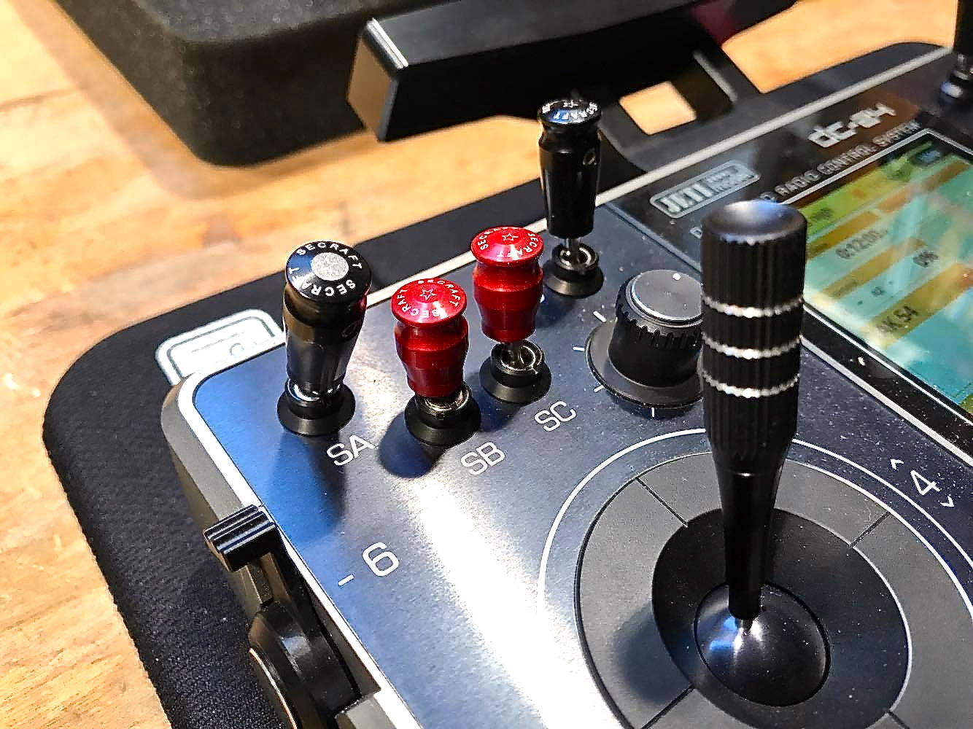
Safety Solutions
Implement ‘Stupid Proof’ solutions, so that anxiety or lack of attention will never result in a crash.
Dangerous commands should go on sliders or knobs.
Switches should activate only flight conditions.
SWITCH
KNOB
SLIDER
STICK

Slide 6
Seminar Outline
Airplane Key Settings
Balance CG
Check engine incidence
Set throws
Align Elevator

Slide 7
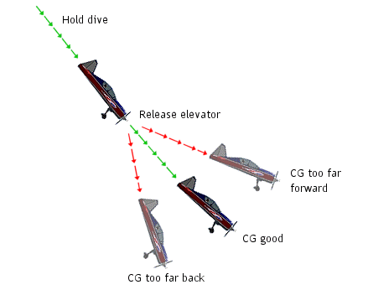
Balance CG
AFTER LEVEL FLIGHT TRIMMING
45° down line, moderate throttle, elevator centered, observe positive or negative pitch:
  If Negative: CG too far back
  If Positive: CG too far forward
Inverted flight, full throttle, elevator centered, observe positive or negative pitch:
  If Positive: CG too far back
  If Negative: CG too far forward
  If very slightly Negative: right CG
Outcome is determined by the trimming required to maintain level flight at full power

Slide 8
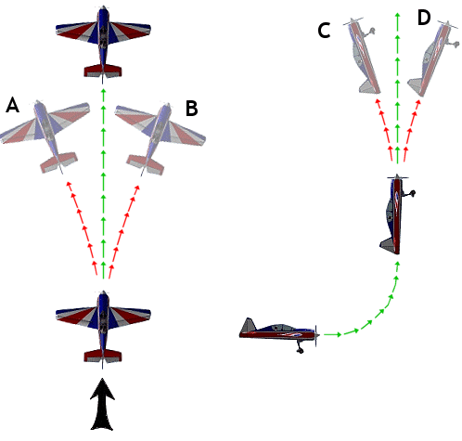
Check Engine Incidence
BEFORE LEVEL FLIGHT TRIMMING
Vertical up-line at full throttle, rudder and elevator centered, observe a significant right or left yaw:
  Modify engine incidence accordingly.
Vertical up-line at full throttle, rudder and elevator centered, observe a significant up or down pitch:
  Modify engine incidence accordingly.
A = insufficient right thrust
B = too much right thrust
C = insufficient down thrust
D = too much down thrust

Slide 9
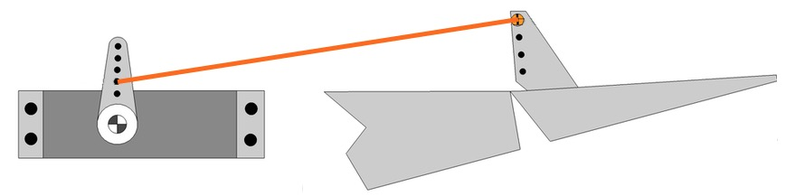
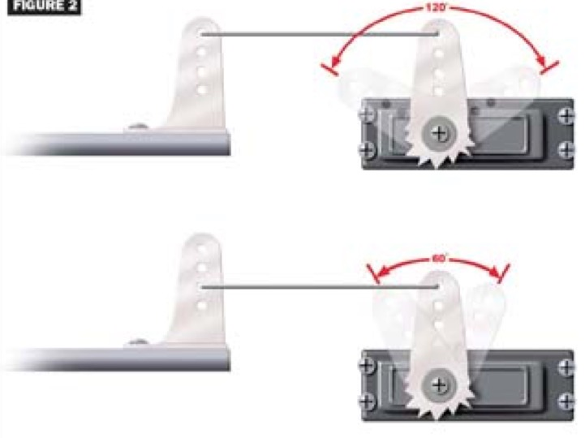
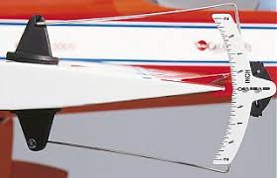
Set Throws
PRECISION AEROBATICS REQUIRES SENSIBILITY
20-30° movement for ailerons and elevator is enough.
Do not de-multiply servo strength installing very long arms on servo and moving surfaces: 1 to 1.5 inches is enough
Maximize the use of all servo 180° pixel range.
If throws are too large, reduce them using ATV or Dual Rates
Less control surface movement, more precision and maximum leverage
Right
Wrong
Maximize the use of your radio sensibility

Slide 10
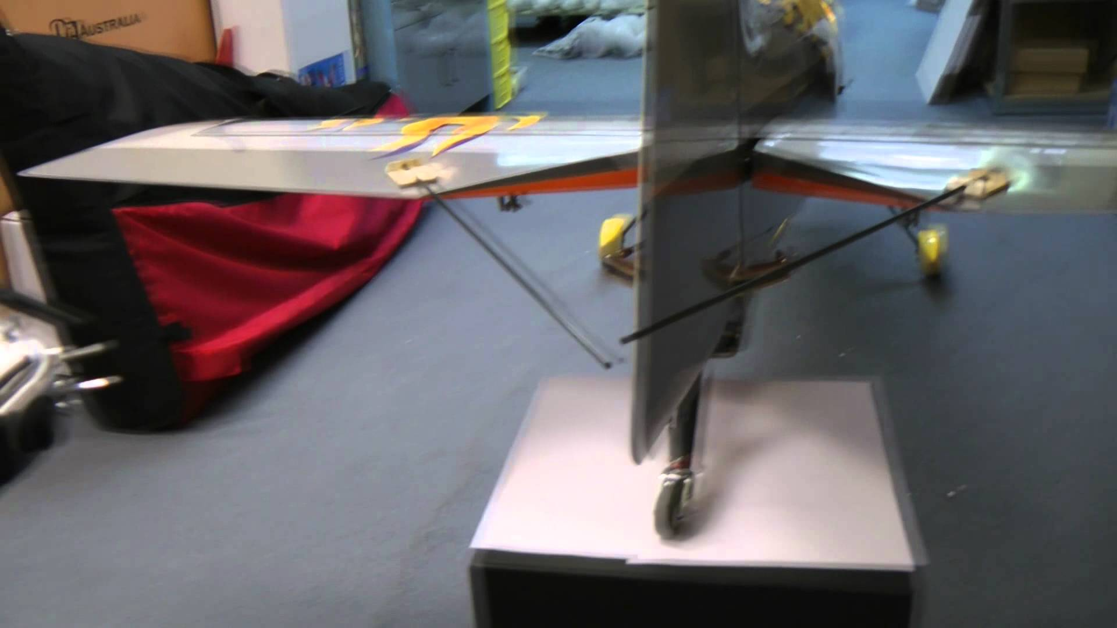
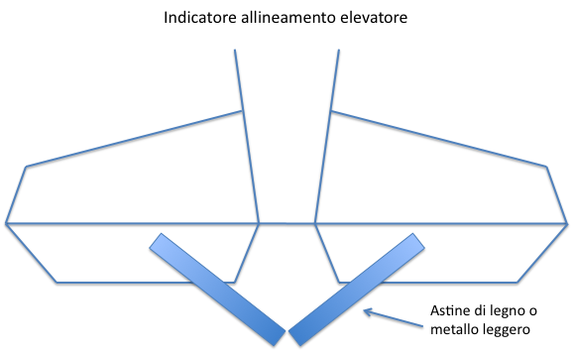
Align Elevator
PREVENT CLIMBS WITH A JAW TO CORRECT
Check alignment of elevators:
ALIGNMENT INDICATOR
However, if your wings are not level when you pitch, you will still experience the need to correct yaw during vertical climb
RIGID STICKS

Slide 11
Seminar Outline
Permanent Radio Settings
Left Turn Tendency
Down Line Positive Pitch
No Straight Rolls
No Power Progression
No Straight Knife Edge

Slide 12
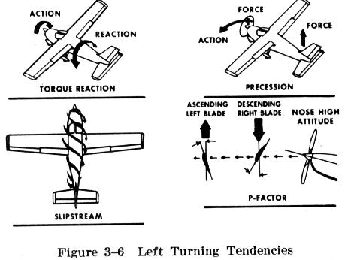
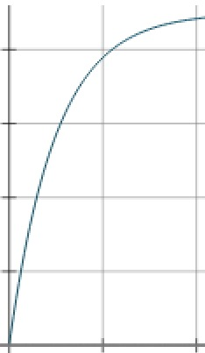
Left Yaw Tendency
AFTER PROPER ENGINE INCIDENCE
SETTING
Vertical up-line at full throttle, you may notice a slight left yaw tendency:
  Introduce a master-slave permanent mix:
    Master: Throttle – Slave: Rudder
    Moving versus max throttle introduce from 2 to 5 points right rudder
    Check servo monitor versus stick position
    If more then 5 points are needed, check engine incidence
This tendency is originated by several aerodynamic factors that are often summarized as ‘Torque Effect’
MAX
FROM 0 TO MAX 5 POINTS RIGHT RUDDER
THROTTLE
MIN

Slide 13

Down Line Positive Pitch
AFTER PROPER CG SETTING
Vertical down line at zero throttle, you may notice a positive pitch tendency:
  Introduce a master-slave permanent mix:
    Master: Throttle Slave: Elevator
    At minimum throttle introduce 2 to 4 points negative pitch
    Check servo monitor versus stick position
    If more then 4 points are needed, check elevator incidence versus wings

Slide 14
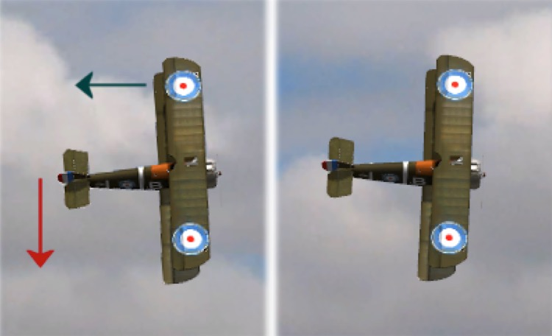
No Straight Rolls
45° Up line, full throttle, sequence of rolls versus left: notice the tendency of flight path to turn right (or vice versa):
  Introduce Aileron Differential:
    Reduce down aileron throw versus up aileron throw by 5 to max 15%
    If more is needed check wings and elevators incidences
Adverse yaw occurs because a downward deflected aileron causes more drag then the upward deflected aileron. This drag pulls the airplane out of flight path during rolls in a direction opposite to roll versus

Slide 15
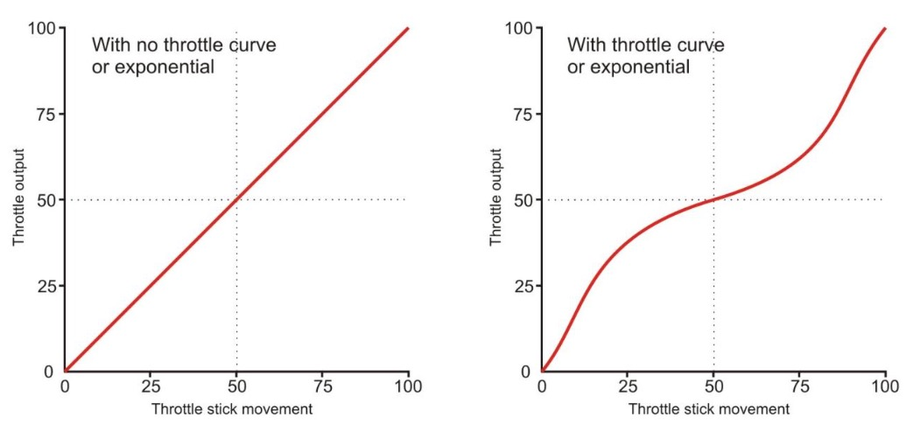
No Power Progression
Do you experience a 90% power position?
Do you feel a cruising speed at 60% power?
Do you experience a slow approach at 30% power?
SET A THROTTLE CURVE
If you do not, then set a throttle curve:
  Normally throttle is less sensitive at intermediate ranges, because our carburetors and engine torque curve do not provide a linear power progression, as we would expect from our linear throttle stick

Slide 16
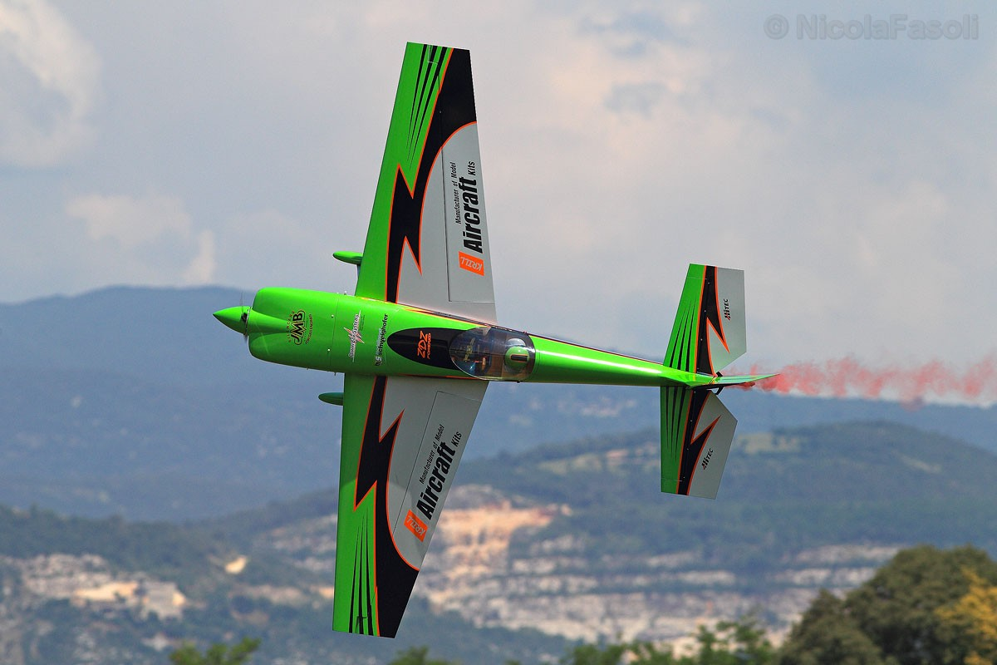
No Straight Knife Edge
Positive or negative pitch on knife edge:
  Introduce a master-slave permanent mix:
    Master: Rudder Slave : Elevator
    Add positive or negative elevator in presence of rudder input
PITCH AND ROLL TENDENCY
Right or Left Roll on Knife Edge:
  Introduce a master-slave permanent mix:
    Master: Rudder Slave : Ailorance
    Add right or left roll in presence of rudder input
Many Pilots prefer this correction as part of a ‘Rolling Circle’ Condition

Slide 17
Seminar Outline
Activated Radio Settings
Throttle Cut
Choke

Slide 18
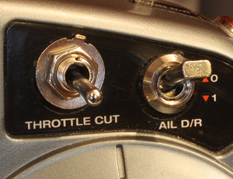
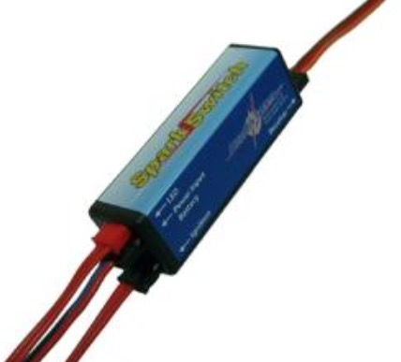
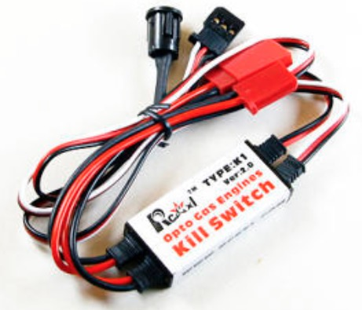
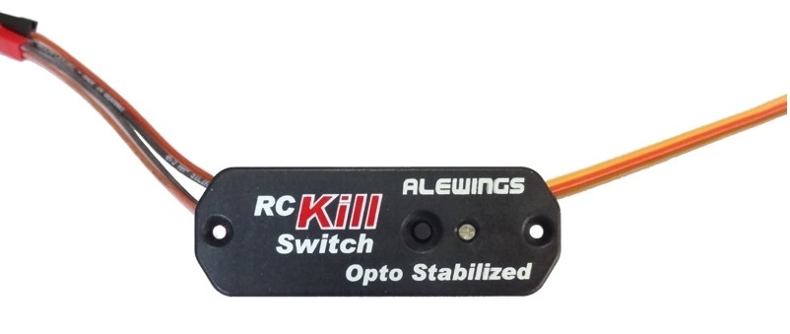
Throttle Cut
MAKE SURE YOU CAN KILL ENGINE AT ANY TIME
Set up a Slider to control Throttle Cut.
  Throttle can be cut by reducing gasoline injection below idle level
  Much safer to use an electronic throttle kill switch
THROTTLE CUT ON A SWITCH IS DANGEROUS
ELECTRONIC KILL SWITCHES

Slide 19
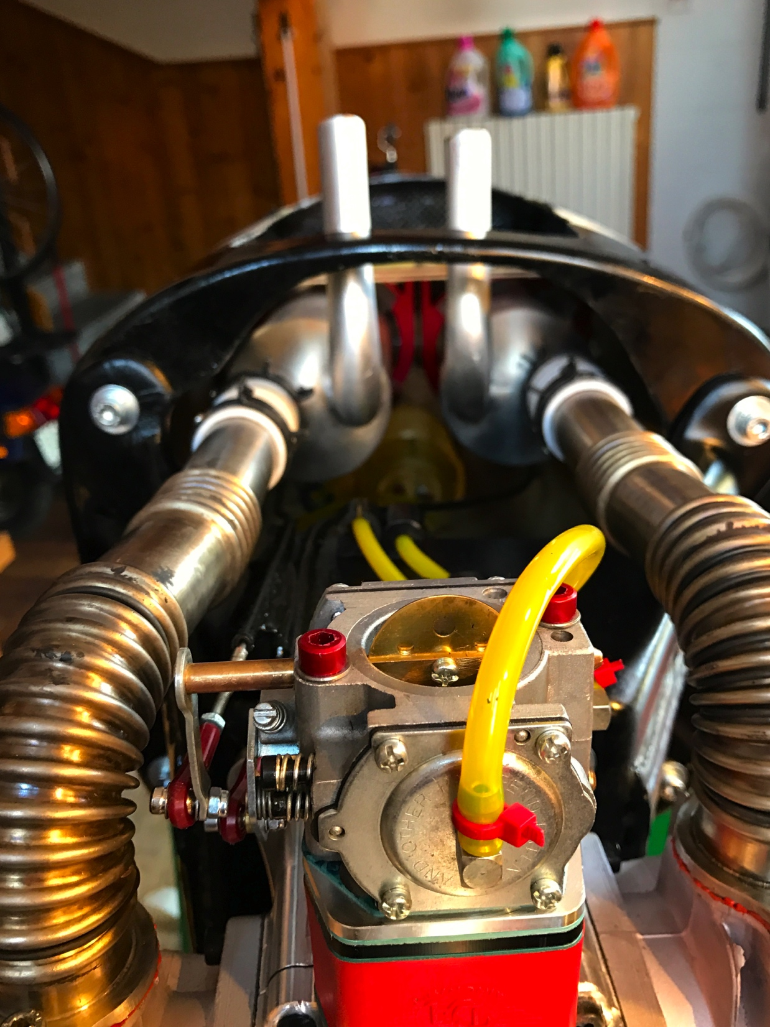
Choke
Set up a Slider to control Choke
  On large airplanes it is handy to install a servo to control choke
  Many Pilots prefer a manual set up because it is lighter
CHOKE CONTROL ARM
On some engines the calm air intake helps mid-range stability

Slide 20
Seminar Outline
Flight Conditions
Create Flight Conditions
Spin
Rolling Circle
Snap
Land
Organize Radio Deck
Setting Flight Conditions is very subjective.
It depends on Pilot’s preferences and airplane performance.
Therefore, the following are just ‘Food for Thought’ ideas.

Slide 21
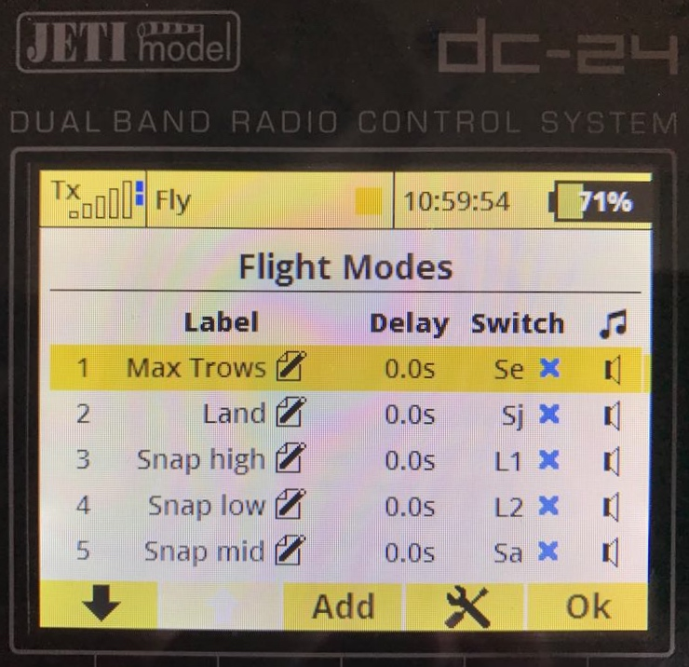
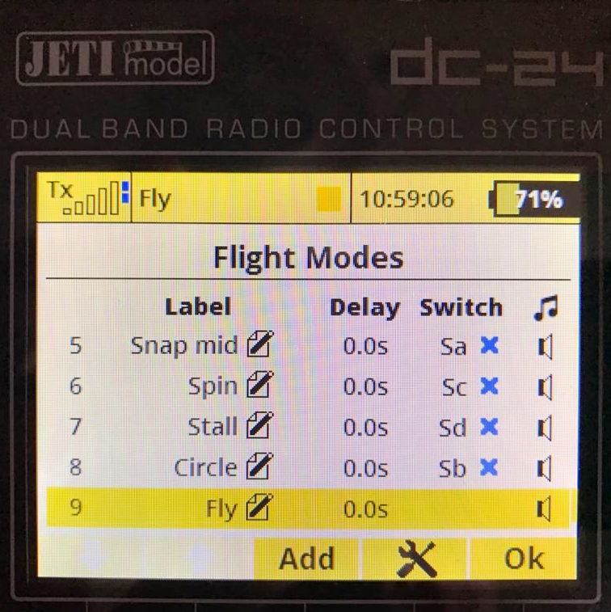
Create Flight Conditions
‘Fly’ = Default Condition
  No switches activation – Default
  Small throws to perform smooth aerobatics (1-1.5 in. servo arms and 20-30° throw)
  Safety Flying idle set in this condition
Create a New Condition
  Add it to the list
  Name it
  Set a Switch to control it
  Then activate the Condition with the switch
  Then set the changes you desire
  At the end check servo monitor for appropriate activation
Set Priorities among Conditions

Slide 22
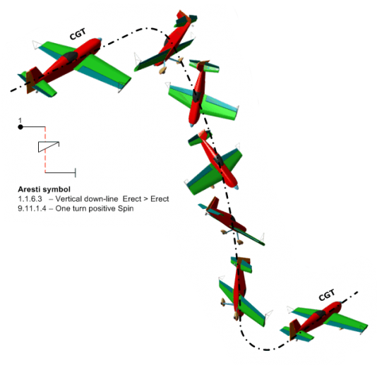
Spin Condition
Activate Spin condition on a switch:
  Increase elevator throw (+30%)
  Increase rudder throw (+20%)
  Set specific throttle idle level
    Mind cylinders cooling danger
Too high safety flying idle setting is the most common cause for stalling difficulty

Slide 23
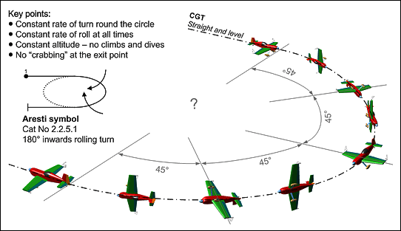
Rolling Circle
Activate Rollin Circle condition on a switch:
  Reduce aileron throw (-10%)
    Reduce exponential (max 5-10% level )
  Reduce elevator throw (-15%)
    Reduce exponential (max 5-10% level )
  Reduce rudder throw (-20%)
    Reduce exponential (max 5-10% level )
Activate Knife Edge mix previously determined

Slide 24
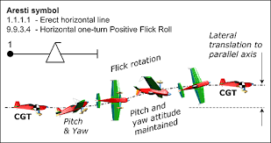
Snap
Activate Snap condition on a switch:
  Slightly Increase Aileron Throw (+5-10%)
  Significantly Increase Elevator Throw (+20-30%)
  Significantly Increase Rudder Throw (+20%)
Activate logical switch on throttle stick:
  Set three snap level conditions automatically activated on the basis of throttle level:
    Snap switch ON
    Throttle level High-Mid-Low each allowing for a specific condition setting

Slide 25

Land
Activate Land condition on a switch:
  Increase Elevator Exponential (+10%-20%)
  Set low idle condition.
  Higher safety flying idle is therefore set within the default Fly Condition

Slide 26

TAXI
Activate Taxi condition on a switch:
  Max Throw on Elevator
  Max Throw on Rudder

Slide 27

Organize Radio Deck
Switches, Sliders and Knobs all activated in the same direction
  All In or All out
  Clock wise or counter
Flight Conditions Switches all in the same deck area (aileron hand)
Dangerous functions on sliders or knobs
MIND
SAFETY
SPIN
VOLUME
CIRCLE
CHOKE
TIMER
ZERO AMP
CONSUMPTION
SNAP
LAND
KILL
ENGINE
TAXI
TURN ON
AIRPLANE
MODE 4

